Slide 1


Improving voice activity detection in hearing aids using visual cues
Peter G. Jacobs, Ph.D.
Research Investigator, NCRAR
Assistant Professor Department of Biomedical Engineering, OHSU
October 19, 2012

Slide 2
Acknowledgements
Funding
Department of Veterans Affairs Career Development Award (CDA-1 C7693-M)
Grant title: Integrating Auditory and Visual Information to Improve Hearing Aids
Mentor
Gabrielle Saunders, PhD

Slide 3
Statement of the Problem
28 Million People in U.S. Suffer From Hearing Impairment
1 in 5 over age 70 are both legally blind and have hearing deficits (dual-sensory impaired)
Current Hearing Aid Technology is Unsatisfactory
Amplification & Filtering is Primary Solution
Directional microphones & binaural devices also used
Speech in noise still a major problem
No solutions for dual-sensory impaired patients

Slide 4

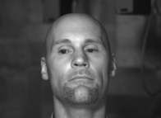
Evidence supporting use of visual information
People comprehend 50 - 60% more when presented visual + auditory information compared with auditory alone

Slide 5
No shortage of noise removal options
Current methods for noise removal in hearing aids
Directional microphones
Adaptive microphone arrays
Low-level expansion
Adaptive filtering
Envelope modulation filters
Atlas et al, 2005, Souza et al. 2005
Spectral subtraction
Wiener Filtering

Slide 6
Noise Removal Methods Multiple Microphones
θ
X₁(t)
Σ
Separation
d
Front Mic
Delay
Gain
Rear Mic
X₁(t)

Slide 7
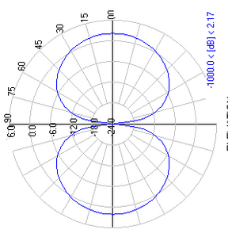
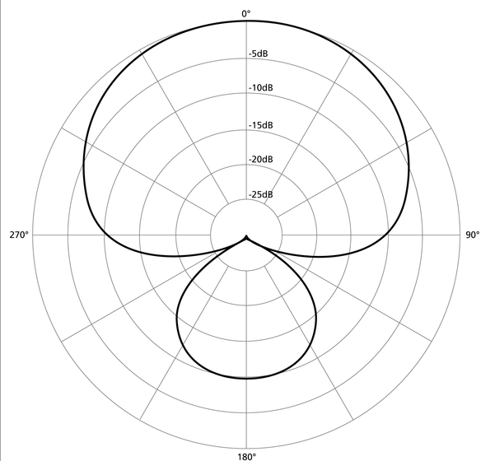
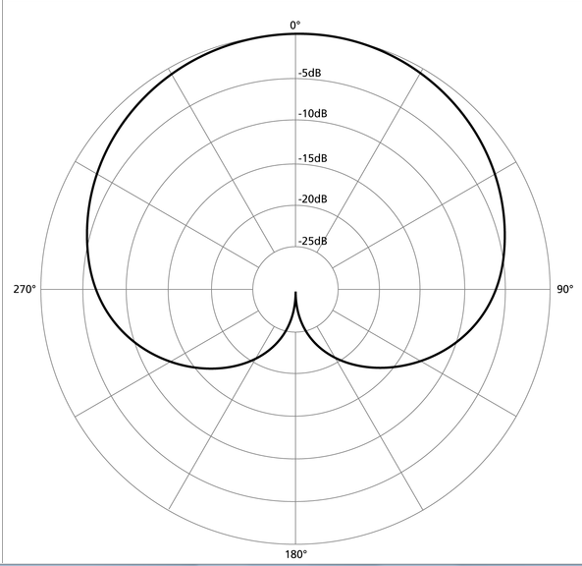
Noise Removal Methods Polar pattern can be steered by adjusting the delay (τ)
Dipole
Super cardiod
Cardiod

Slide 8
Noise Removal Methods Single-mic
Low-level expansion
Output
Input
Adaptive filtering
In
High-pass filter
Out
Low-pass filter
|.|
Smooth
Filter control

Slide 9
Noise Removal Methods Envelope modulation
Envelope modulation filtering
Atlas et al. 2005
Carrier detect
BP Filt 1
Env Detect
Smooth envelope
X
BP Filt 1
BP Filt 2
In
…
Σ
Out
BP Filt N

Slide 10
Noise Removal Methods Single mic noise estimation and removal
Estimate noise, and then subtract
Spectral subtraction
Wiener filtering
Ephraim Malah MMSE (1985)
Noise
d(n)
Block-process
FFT
Wiener Filter
G(f)
IFFT
Overlap & Add
Signal
s(n)
Σ
y(n)
x(n)

Slide 11
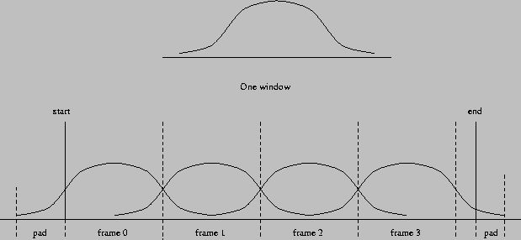
Block processing and windowing
Chop up signal into frames
Overlap frames to minimize transition artifacts
Use Hamming window to minimize frame edge-effects

Slide 12
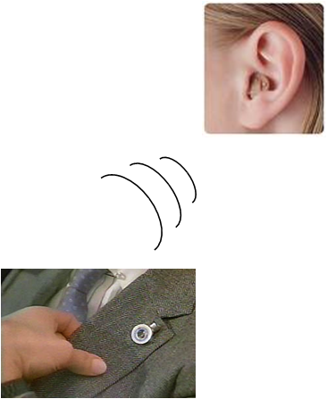
Introduction – Proposed futuristic system
Hearing aid receives the video features wirelessly
Video camera wirelessly sends data
Mounted on lapel…
BTE Hearing aid
eye-glasses

Slide 13
Long-term objective
Use both audio and visual cues to improve speech intelligibility
Better voice-activity detection
Improved envelope modulation
Improved adaptive microphone array processing
Improved spectral subtraction / Wiener filtering through better noise identification

Slide 14
Short-term objective
Design a method for improved voice activity detection (VAD) algorithm using visual cues
Train the algorithm on different speakers and at different signal-to-noise ratios (SNR)
Evaluate the algorithm on a new dataset not seen during the training.

Slide 15
Background on VAD
Detecting voice / no-voice is important in estimating noise spectrum
VAD is front end of many noise removal algorithms in hearing aids
Acoustic only VADs use different statistics of speech and noise
Sohn, Kim, and Sung, 1999
Tend to fail in low SNR conditions
Others have demonstrated correlation of face with vocal tract (Yehia et al. 1998) and have exploited the correlation for
Speech enhancement (Girin et al. 2001; Deligne et al. 2002)
Speech source separation (Sodoyer et al. 2004, Rivet et al. 2005)
And voice activity detection (Sodoyer et al. 2006)

Slide 16
Audio-visual corpus
Revised speech-in-noise (RSPIN) data corpus
Two speakers recorded (audio and visual) of face in anechoic chamber
Video recorded using 96 fps Basler black-and-white camera
Audio recorded using LYNX2B sound card, 24-bit resolution
Introduce cafeteria noise at different signal-to-noise ratios during post-processing

Slide 17
Overview of audio-video feature extraction
Cafeteria noise
Autocorrelation
Block-process
FFT
24-Critical Bands
VAD Detection
Speech
44.1 ks/sec
Σ
Video
96 fps
Extract 66-points on face
Lip height/width
d ./dt
Fit ellipse to outer lips
d ./dt

Slide 18
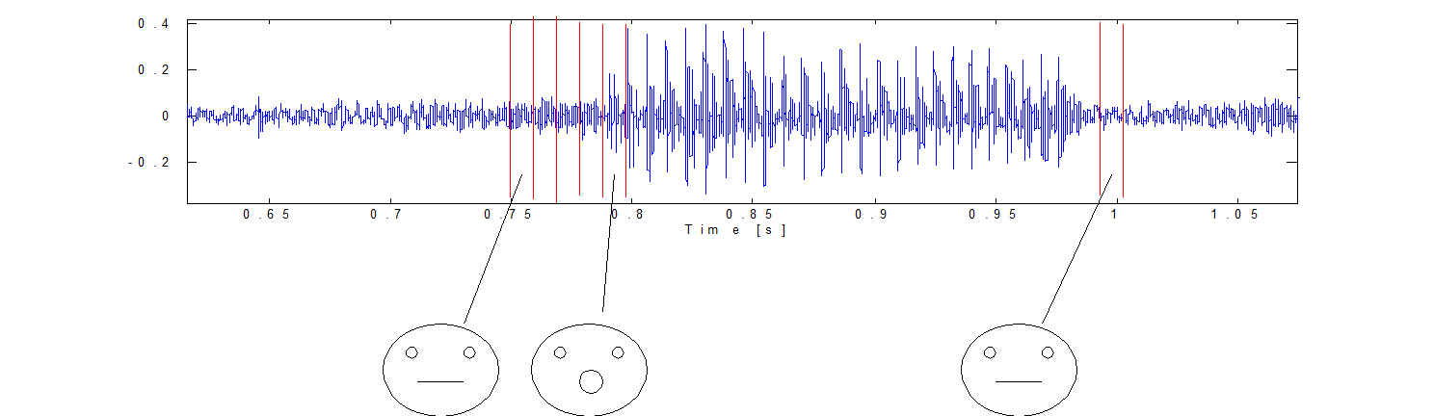
Auditory and visual signal processing
Audio is segmented into 10.4 ms frames with 40% overlap
Each frame corresponds with a video frame
Visual and audio features are extracted frame-by-frame

Slide 19
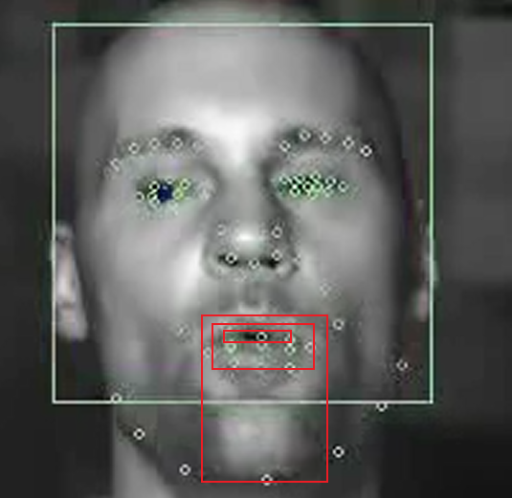
Introduction – Facial Feature Extraction
Visual feature (β_{v}) extraction – 66 visual features around mouth, eyes, chin, nose and cheeks
100 ms to extract
Visual features include
Height of outer lips
Height of inner lips
Width of mouth
Height of upper-lip to chin
Ellipse parameters fit to the outer lips
Change in features over time

Slide 20
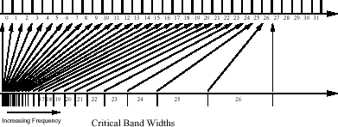
Auditory Feature Extraction
Auditory features (β_{a}) include
First 24 critical bands
Autocorrelation of current frame, which is a measure of periodicity

Slide 21
Model Prediction of Voice Presence/No Presence
Train a logistic regression model on speaker 1 across different SNRs
Evaluate model on new speaker, new SNR not used during testing.

Slide 22
Statistically relevant (p<0.05) model parameters
Audio parameters
Bands 3-15, 18-21, 23-24
Autocorrelation
Video parameters
Height of outer lips
Height of inner lips
Width of mouth
Height of upper-lip to chin
Ellipse parameters fit to the outer lips (height and width)
Change in features over time

Slide 23
Results
Incorporating visual features improved accuracy of voice detection, especially at low SNRs (Below is at -12 dB SNR)

Slide 24
Results
Detection using audio features alone was good for high SNR
SNR = +6 dB

Slide 25
Results
As SNR drops, the value of incorporating visual features can be observed
SNR = -6 dB

Slide 26
Results
For very low SNR, detection is driven by the visual features
SNR = -12 dB

Slide 27
Results
Training on subject 1 and test on subject 2, lowered accuracy, but a benefit was still observed by using visual features
SNR = -12 dB

Slide 28
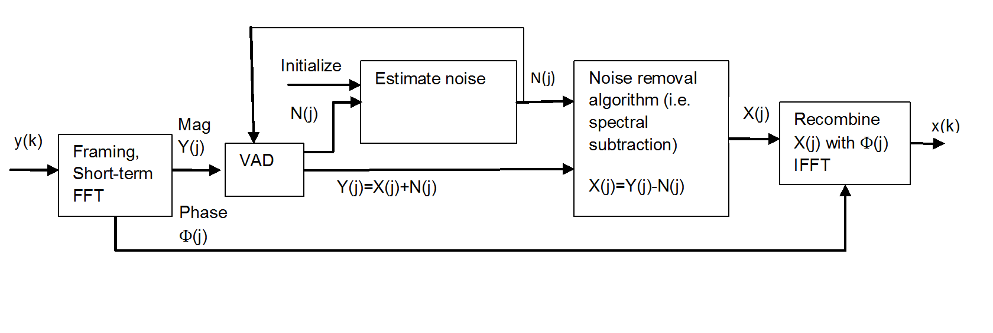
Testing VAD within full noise reduction algorithm

Slide 29
Testing VAD within full noise reduction algorithm

Slide 30
Future Directions
Use video features to smooth envelope in envelope modulation noise removal schemes
Use video features to control adaptive filters
Use video features to steer adaptive directional microphone

Slide 31
Future Directions
Adaptive directional microphone steering
θ
+
X₁(t)
Σ
+
Σ
Delay
d/c sec
-
Separation
d
Front Mic
-
Delay
d/c sec
-
Σ
Gain
b
Rear Mic
+
X₂(t)

Slide 32
Thank you!
Funding
Department of Veterans Affairs Career Development Award (CDA-1 C7693-M)
Grant title: Integrating Auditory and Visual Information to Improve Hearing Aids
Mentor
Gabrielle Saunders, PhD

